Slide 1
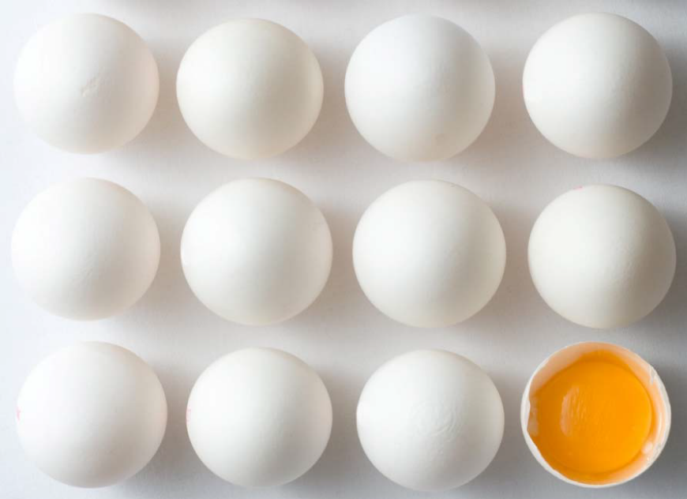
EU Market Situation for
Eggs
Committee for the Common Organisation of the Agricultural Markets
22 November 2018

Slide 2
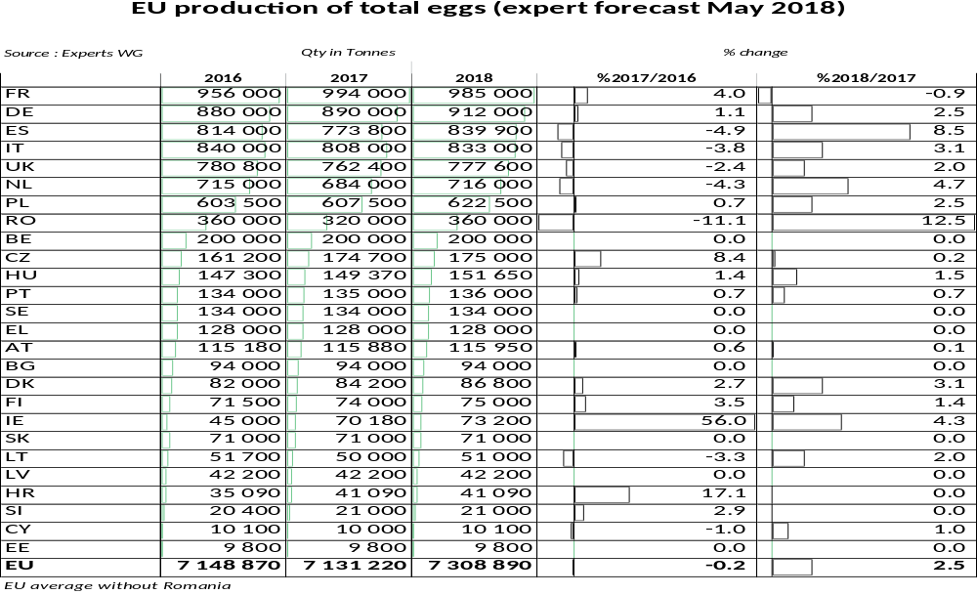
F O R E C A S T

Slide 3
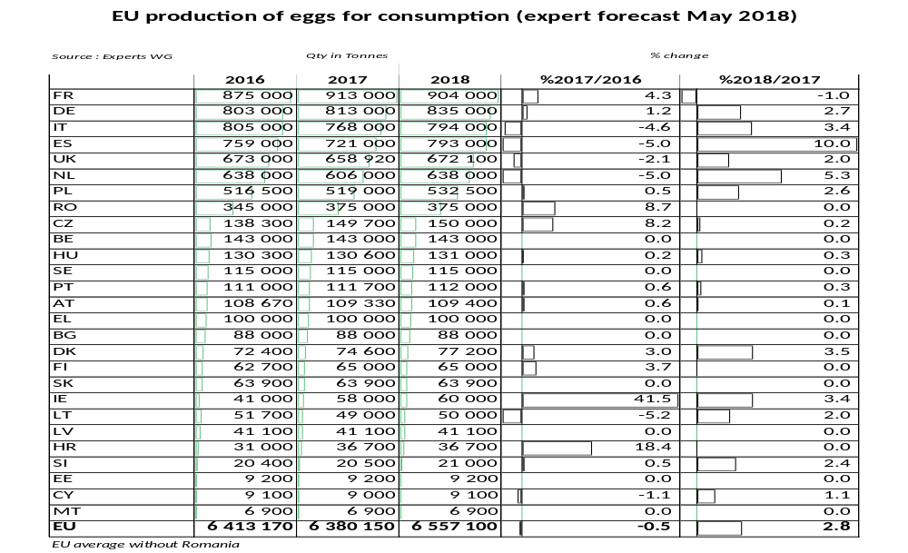
F O R E C A S T

Slide 4
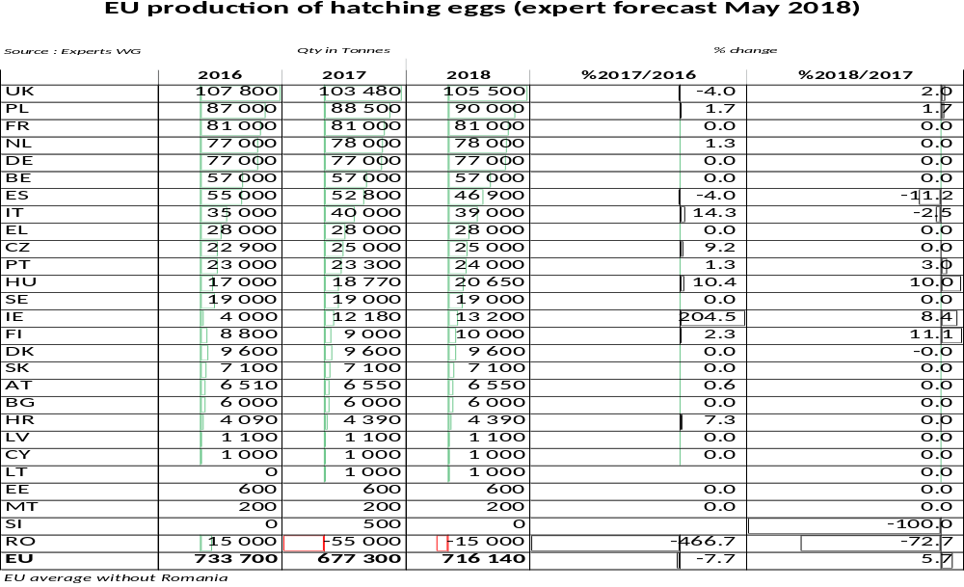
F O R E C A S T

Slide 5
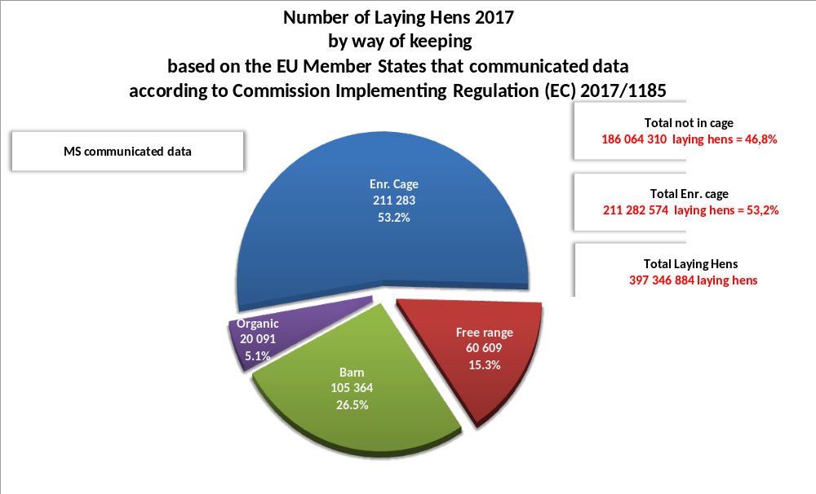
Notes:
Will refer to the nr of hens later, putting this as a reminder.

Slide 6
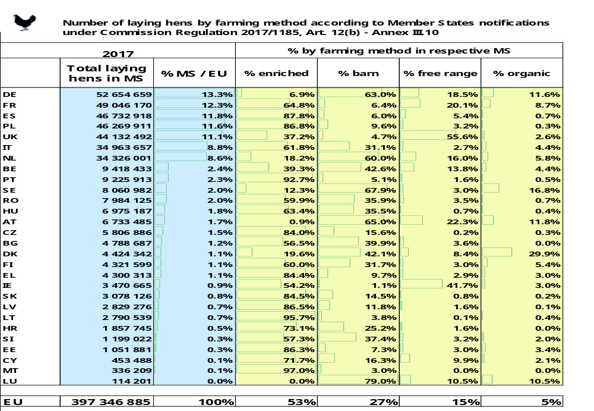
LAYING HENS

Slide 7
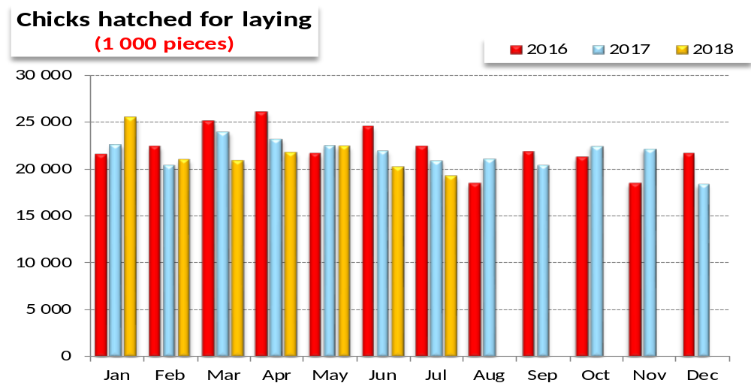
P L A C I N G S

Slide 8
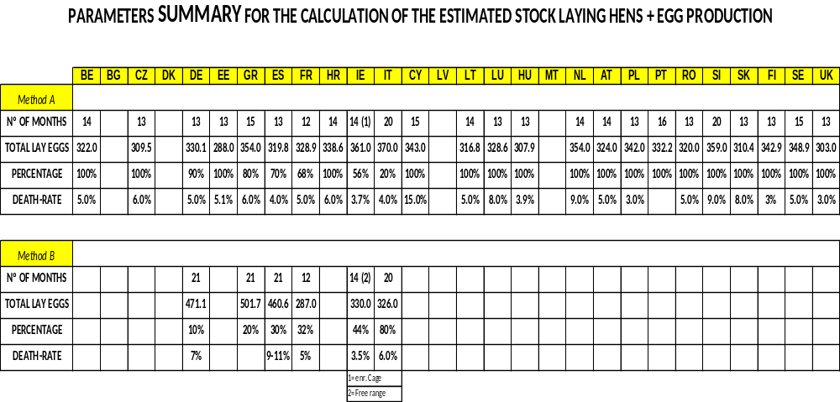
P L A C I N G S

Slide 9
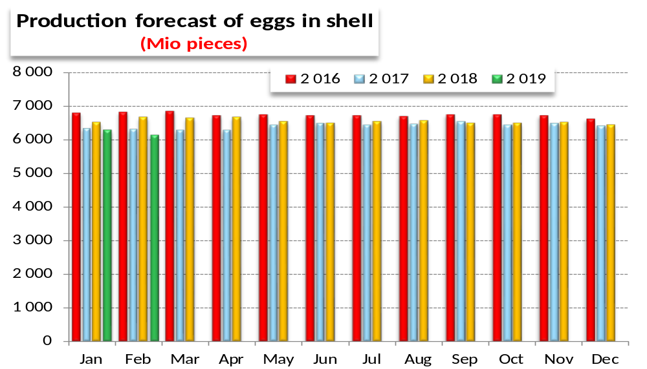
P R O D U C T I O N

Slide 10
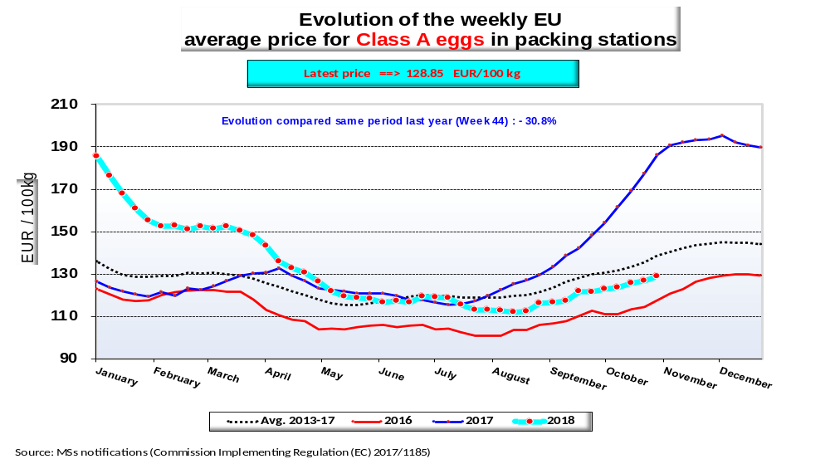
P R I C E S
E U E V O L U T I O N
E G G S

Slide 11
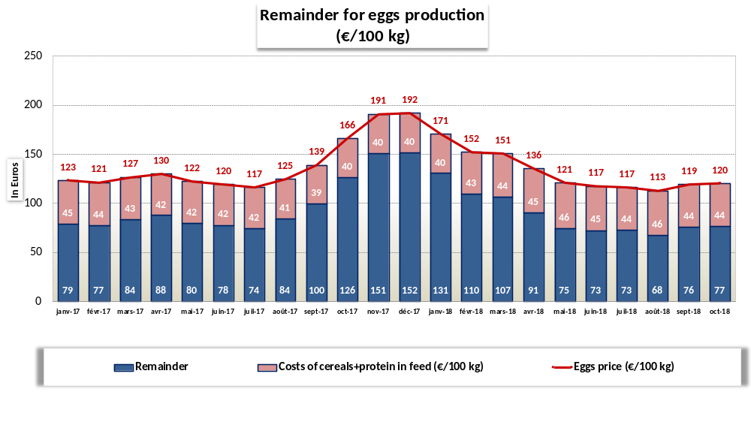
P R I C E S
REMAINDER
E G G S

Slide 12
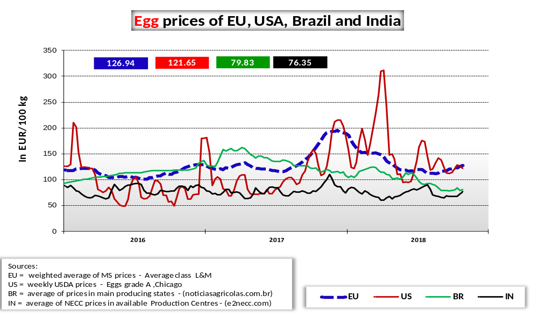
W O R L D
M A R K E T
E G G P R I C E S
EU – US – BR & IN

Slide 13
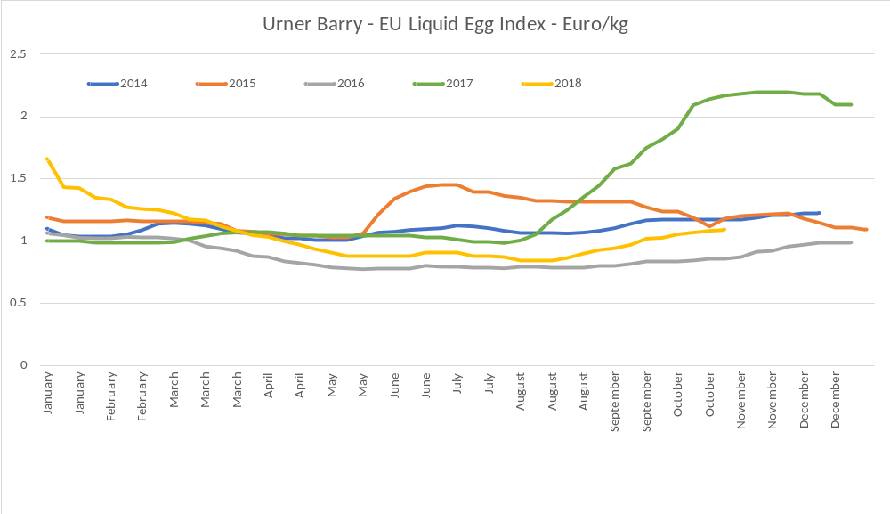
P R I C E S
E U E V O L U T I O N
E G G S
www.ubcomtell.com

Slide 14
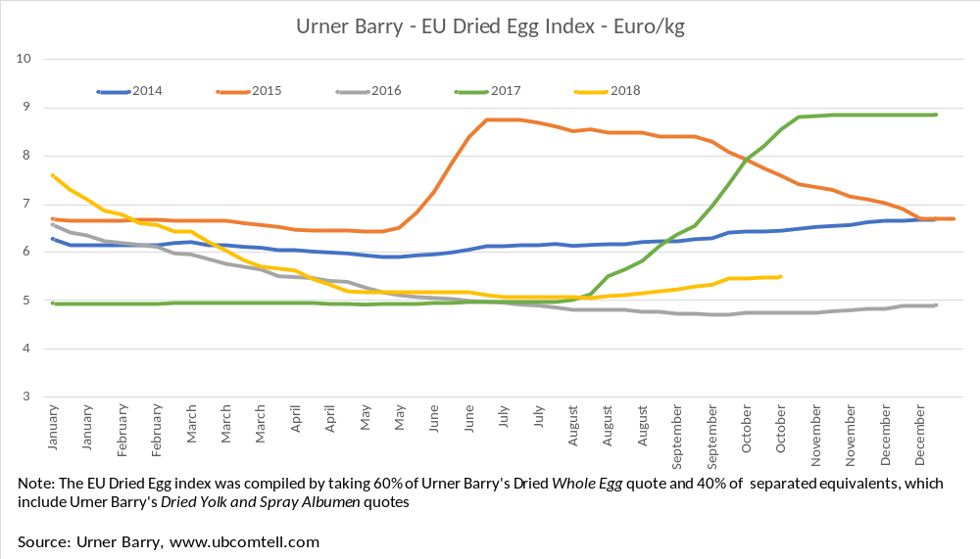
P R I C E S
E U E V O L U T I O N
E G G S
EU market situation for Eggs 22 November 2018

Slide 15
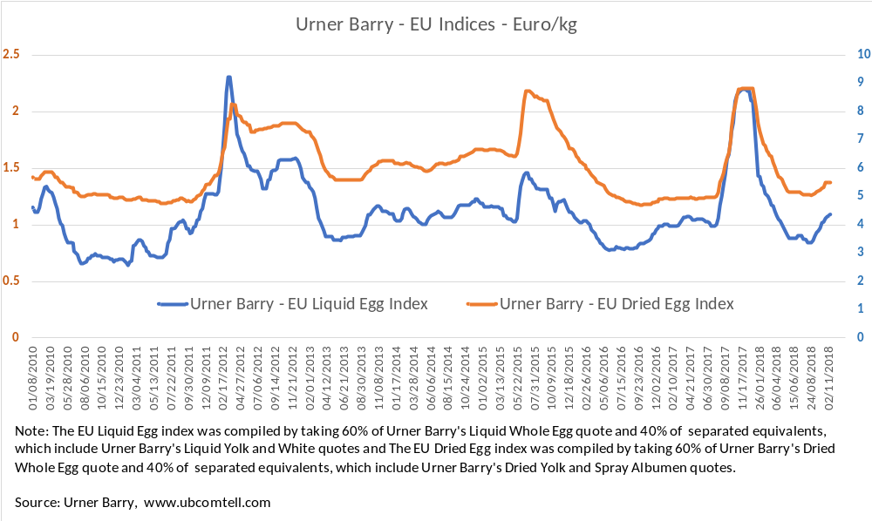
P R I C E S
E U E V O L U T I O N
E G G S

Slide 16
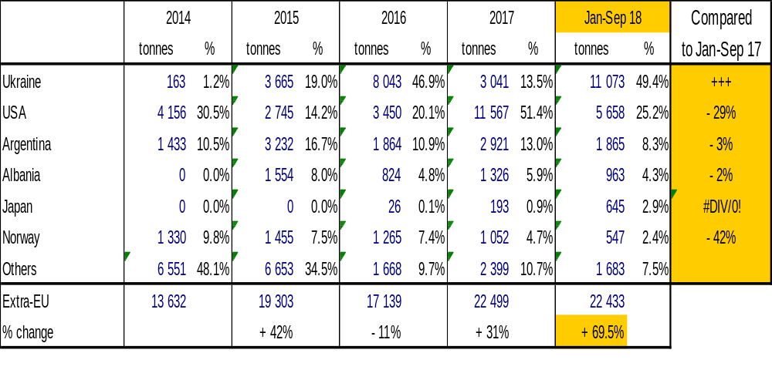
T R A D E
E U I M P O R T S
E g g s
EU Imports of Eggs:
Trade Figures (Comext – tonnes egg equiv.) not incl. Hatching eggs

Slide 17
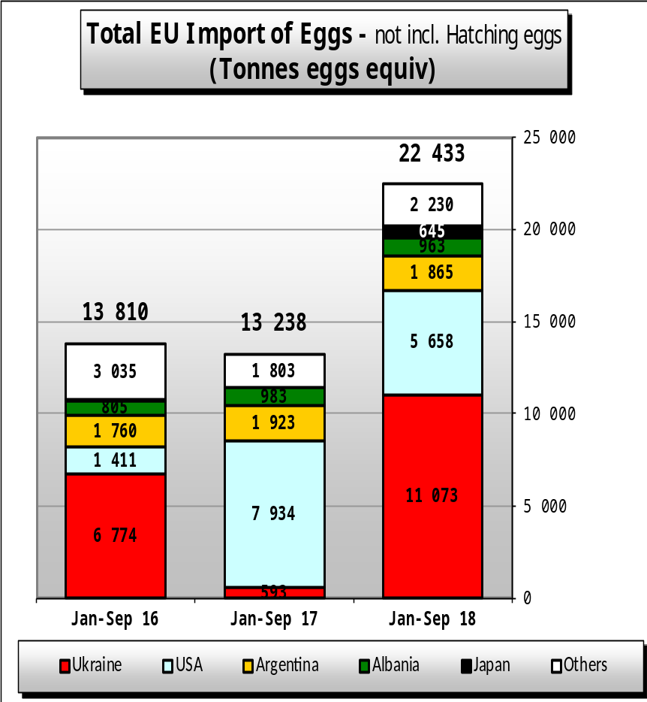
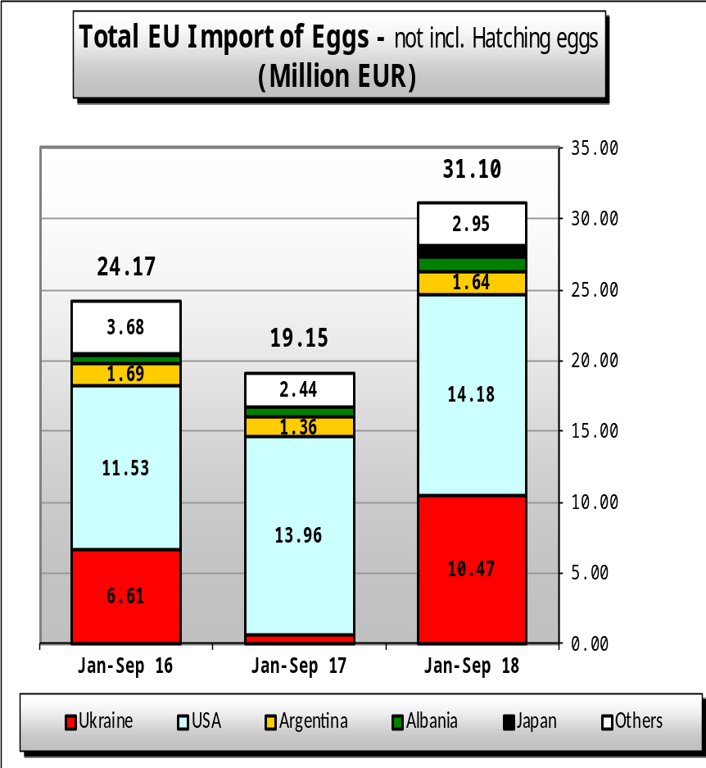
EU Egg Imports
T R A D E
E U I M P O R T S
E g g s

Slide 18
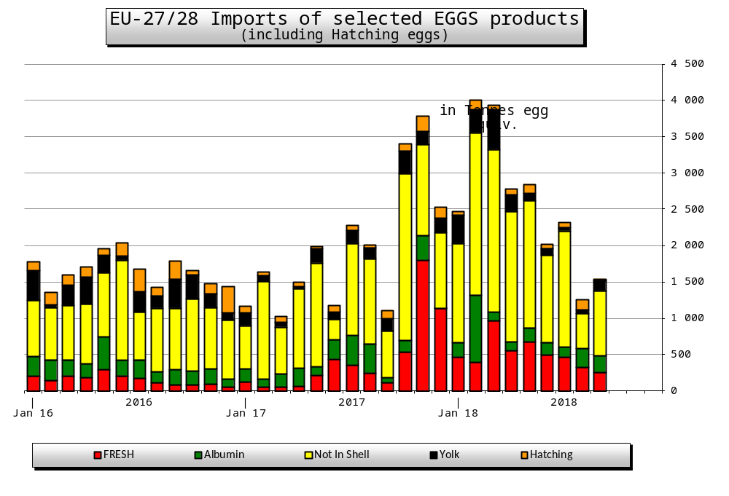
T R A D E
E U I M P O R T S
E g g s
Exports of poultry hatching eggs during January-August 2018 was 57 281 tonnes (egg equivalent).

Slide 19
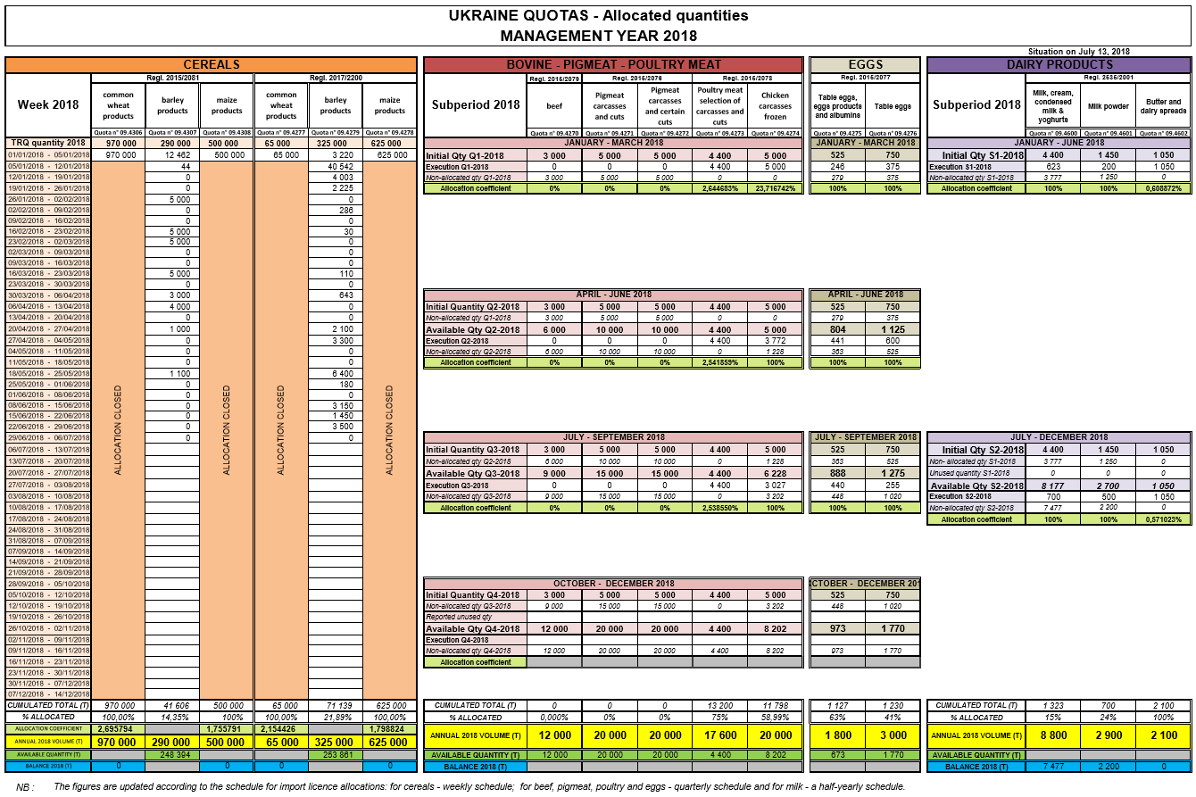

Slide 20
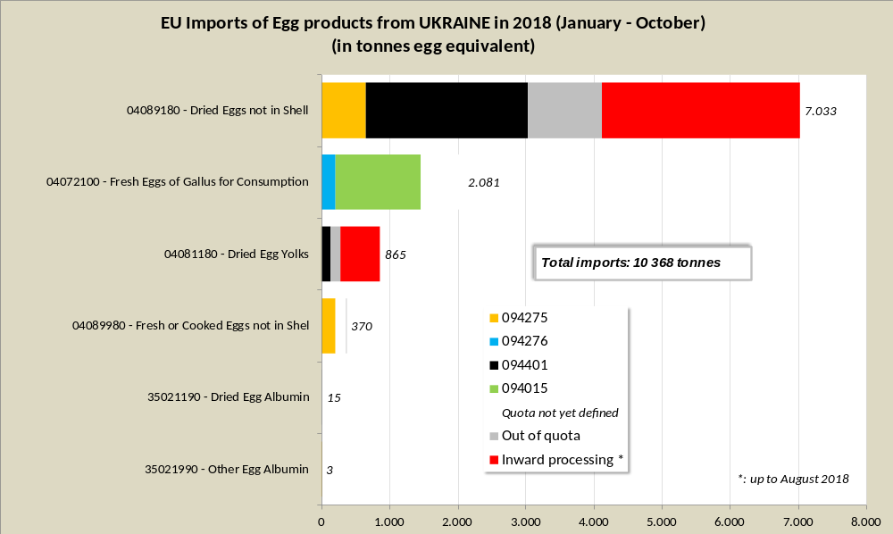

Slide 21
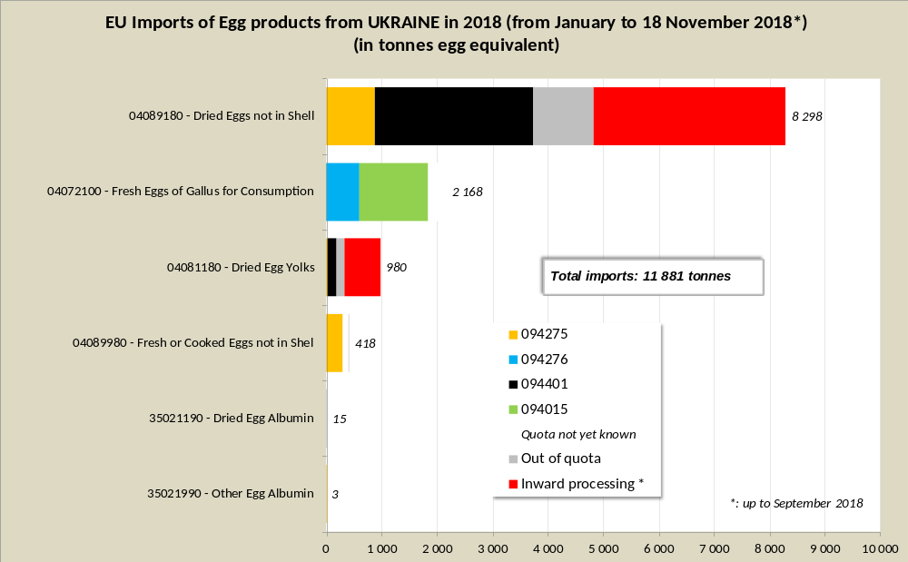

Slide 22
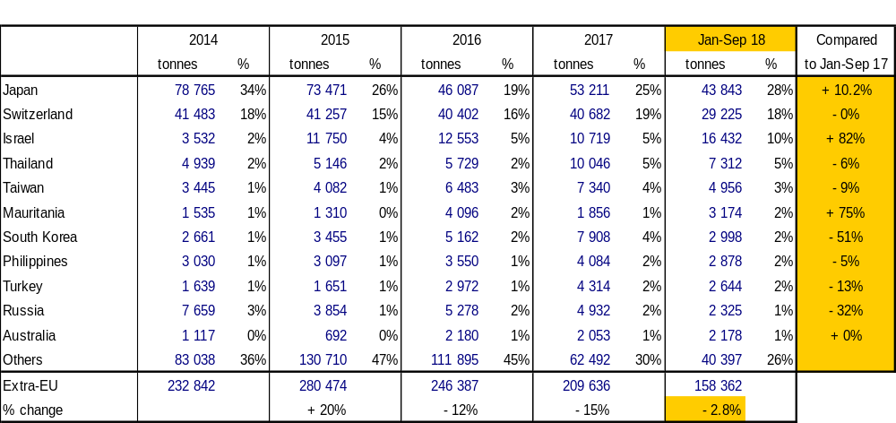
T R A D E
E U E X P O R T S
E g g s
EU Exports of Eggs:
Trade Figures (Comext – tonnes egg equiv.) not incl. Hatching eggs

Slide 23
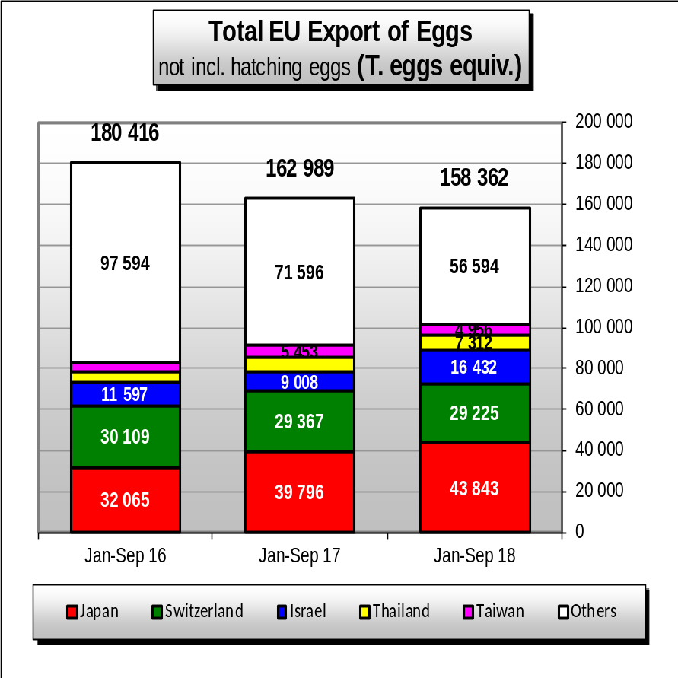
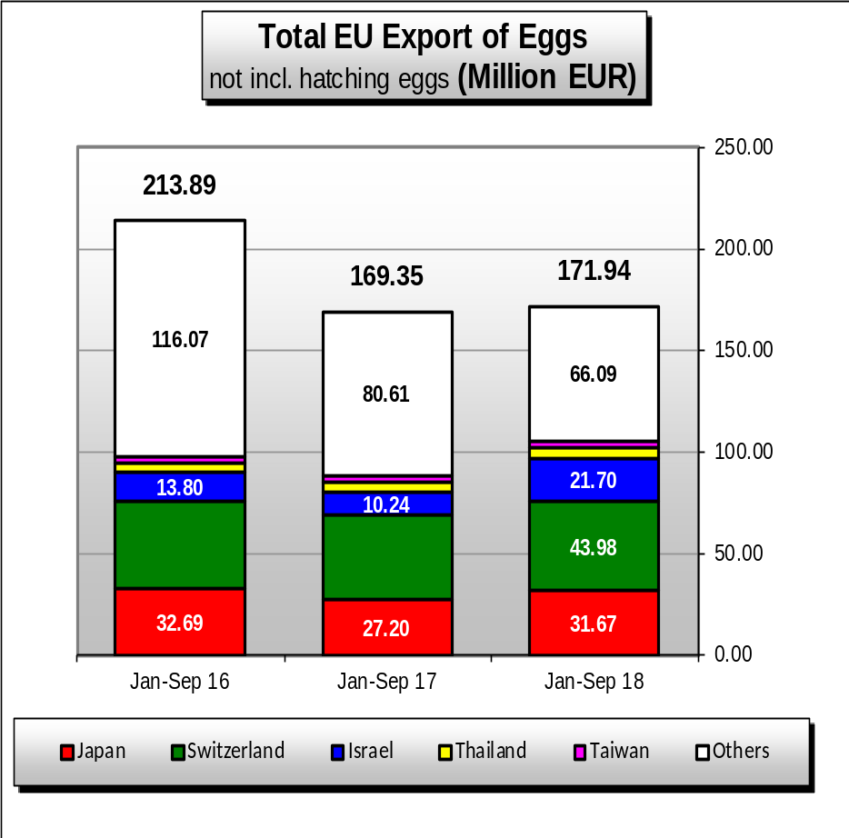
EU Egg Exports
T R A D E
E U E X P O R T S
E g g s

Slide 24
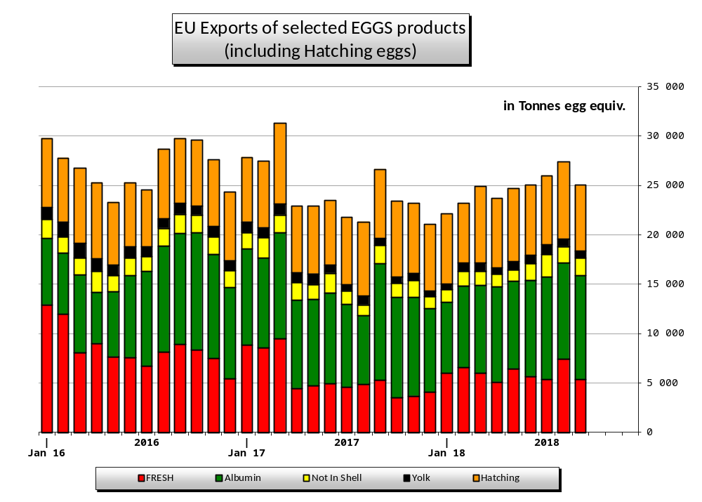
T R A D E
E U E X P O R T S
E g g s

Slide 25
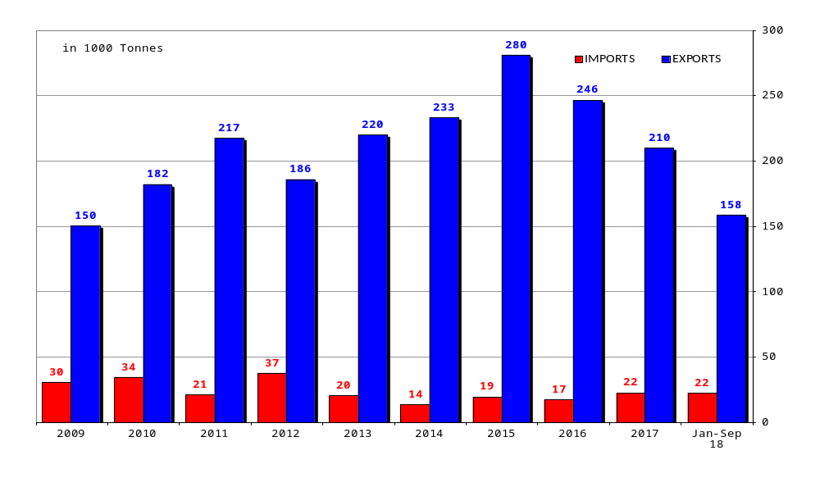
T R A D E B A L A N C E
EU Egg Trade Balance (not including Hatching eggs)
Notes:
Export Import Quote
2016 246 17 14.5
2017 210 22 9.5
2018 158 22 7.2

Slide 26
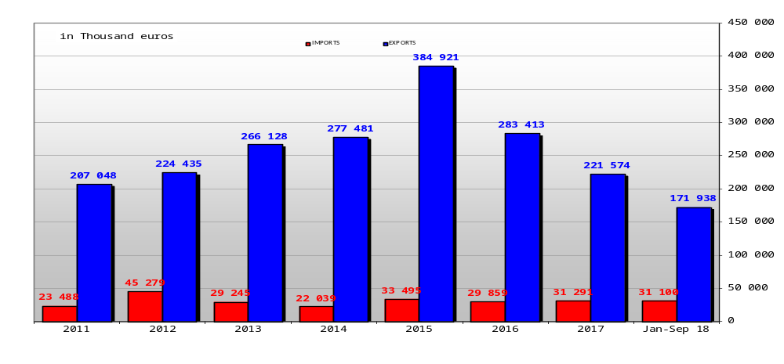
T R A D E B A L A N C E
EU Egg Trade Balance (not including Hatching eggs)

Slide 27
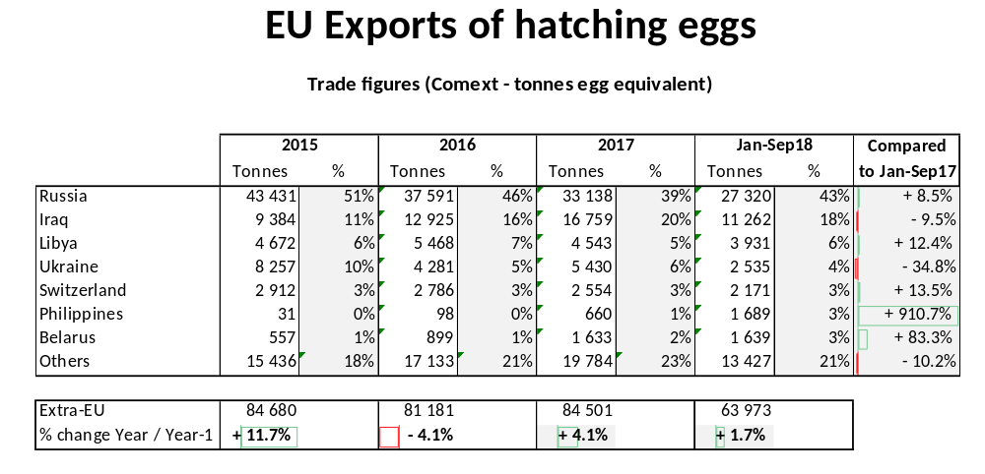
T R A D E Hatching eggs

Slide 28
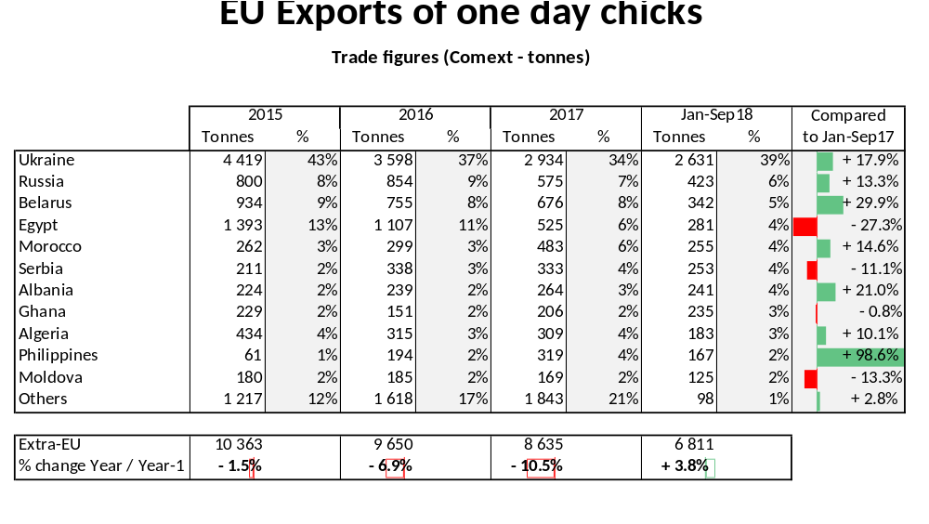
T R A D E 1 Day chicks

Slide 29
EUROPA SITE MARKETS
Where to find data:
http://ec.europa.eu/agriculture/markets/index_en.htm
Click on link: Eggs
Click on link: Presentations and prices
(righthand side under: in this chapter)
Choose the item (link) you want

